Slide 1
Updated S-100 Part 10c HDF5 Data Model and File Format S-100 WG3 10-13 April 2018
Julia Powell
Coast Survey Development Laboratory
Office of Coast Survey
NOAA
Raphael Malyankar
Eivind Mong
Work performed under NOAA sponsorship

Slide 2
Requirements
Harmonize formats for coverage spatial types
Several are currently under development – S-111, S-102, S-104
S-100 3.0.0 has general notions for imagery and gridded data but leaves details to product specification authors.
An ECDIS application should be able to read any data product that claims conformance to Part 10c, without requiring the implementation of product-specific software modules.
Handle the different types of coverages listed in S-100 § 8-6.2.2:
Multipoints, rectangular and irregularly shaped grids, variable cell sizes, TIN
Grids in 2 or 3 dimensions
Simple and tiled grids
Handle time series and moving platform information
Clear mapping between data format and S-100 feature catalogues
Links between HDF5 information and S-100 vector information

Slide 3
Overview of extensions to Part 10c
Specification of mapping between HDF5 and S-100 constructs
Extracts from XML feature catalogues are encoded in a specific HDF5 object (Feature Information Group – “Group_F”). The extracts provide enough information to process the HDF5 file standalone.
Features and attributes in S-100 feature catalogues are linked to objects in the HDF5 file via use of the “code” (camel-case name) defined in the feature catalogue.
Selected metadata elements defined in S-100 are encoded in the HDF5 file.
Specification of logical layouts for spatial information (coverage geometry) and data values
Rules for naming data objects for features, attributes, and spatial coordinates
Rules defining the data structures for spatial information and data values information
Rules for structuring the HDF file and the objects it contains
Provision for referencing feature and information types defined in GML and ISO 8211 files
Requirements, guidelines & hints for product specification authors and implementers

Slide 4
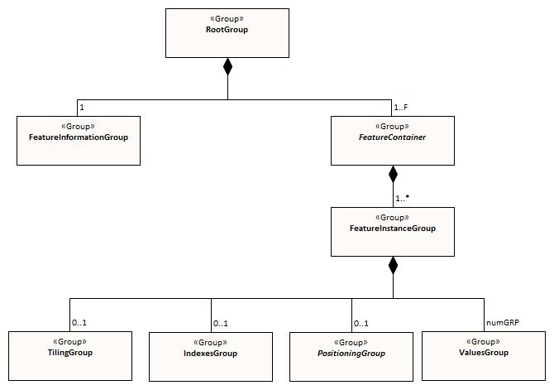
Basic logical structure
Dataset Metadata
Container for all instances of a feature type + metadata common to all the feature instances
Single feature instance + instance-specific metadata
Data values (thematic attribute values)
(> 1 group for time series data)
Type spec. for features and attributes (= S-100 FC + HDF5 extras)
Tiles
Spatial indexes
Feature geometry coordinates
Physical HDF5 file ↔ S-100 dataset
Notes:
The HDF5 specification also defines the concept of “dataset” as one kind of object. HDF5 datasets should not be confused with S-100 datasets. For the purposes of this specification, the equivalent of an S-100 dataset is the whole HDF5 file.
The “root group” is an HDF requirement.

Slide 5
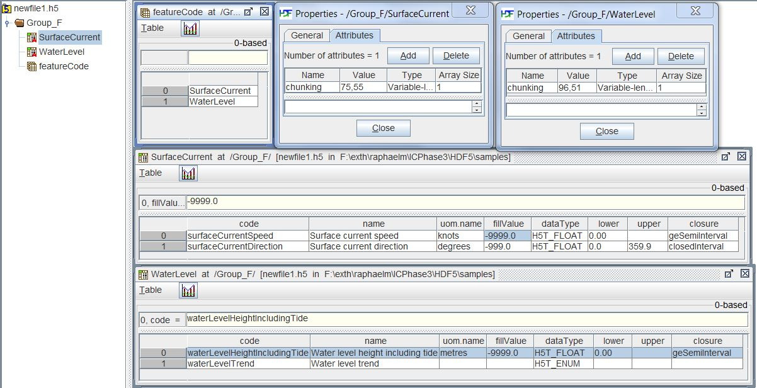
Example of Feature Information group
Notes:
The figure below depicts Group_F for a hypothetical product with two feature types, SurfaceCurrent and WaterLevel. The two features are named (using the camel case codes from the feature catalogue) in the dataset featureCode. The feature description datasets SurfaceCurrent and WaterLevel describe the attributes of each feature type. The feature description datasets are given the same names as the values in the featureCode dataset, which are the camel case codes of the features from the XML feature catalogue. Each feature description dataset is an array of compound type elements, whose components are the 8 components specified in Table 10c-8. The chunk dimensions for the data itself are provides in the chunking attribute of each feature description dataset (shown in the two panels at the top right in the figure).

Slide 6
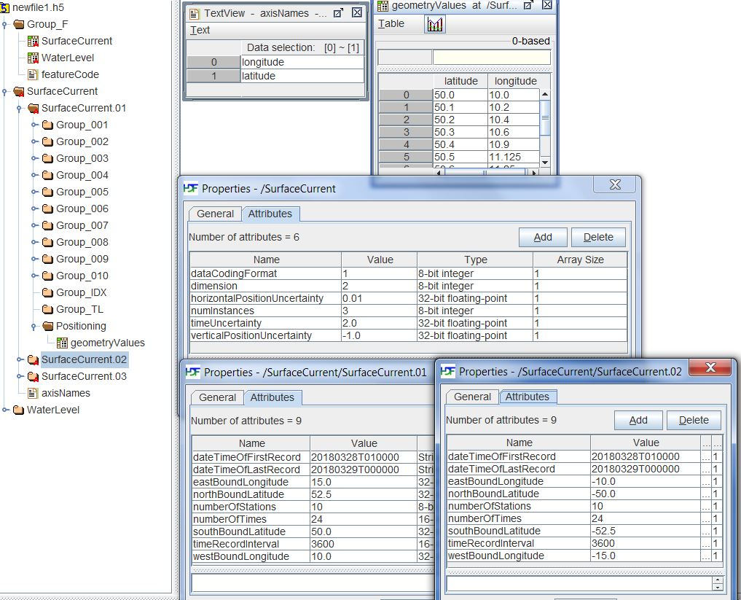
Example of Feature Container and Feature Instance groups
Notes:
The figure below depicts the structure of a hypothetical data file containing 3 instances of the SurfaceCurrent feature type.
The vertical panel on the left shows the overall structure. The data product consists of 2 features (SurfaceCurrent and WaterLevel). Each is represented by a group just under the root group. The Feature Information group described earlier (section 10c-9.5) is also shown.
The Feature Container group named SurfaceCurrent contains 3 instances of the SurfaceCurrent feature type (hypothetically, data for 3 separate places, each with a local coverage grid). Each instance contains subgroups (Group_001, etc.) for time series data.
Locations are encoded in the geometryValues dataset in the Positioning group (panel at top right). The axisNames panel to its left names the components of the geometryValues (i.e., the coordinate axes).
The SurfaceCurrent panel in the the middle shows the metadata attributes common to all instances, which are attached to the SurfaceCurrent feature container group.
The two panels at the bottom show the instance-specific metadata for the feature instances SurfaceCurrent.01 and SurfaceCurrent.02.

Slide 7
Storage of coordinates and data values
Coverage type | Coordinate values | Data values
Regular grid | Not explicitly stored Computable from metadata | D-dimensional array of value tuples
Irregular grid | Not explicitly stored Computable from metadata | 1-d array of value tuples + information about location of cells
Variable cell size grid | Not explicitly stored Computable from metadata | 1-d array of value tuples + information about cell size and location
Fixed stations, ungeorectified grid, moving platform | 1-d array of coordinate tuples | 1-d array of value tuples
TIN | 1-d array of coordinate tuples + triangle information | 1-d array of value tuples
The datasets storing coordinates and values are designed so as to use uniform data storage structures across different coverage types as well as reduce the total data volume.
Notes:
‘D’ is the number of dimensions of the coverage.
The uniformity and volume reduction criteria resulted in storing the additional information needed by some coverage types separately (e.g., cell location and size information for irregular and variable cell size grids).

Slide 8
Metadata principles
The Exchange Catalogue and ISO metadata files are the same as for other formats
Metadata is of two types: (i) `ordinary’ metadata e.g., S-100 discovery metadata, and (ii) grid parameters
Metadata is attached to levels appropriate to the subset of objects it covers.
Metadata attached to the root group applies to the whole file (e.g., issue date)
Metadata attached to feature containers applies to all features inside that container (nominally, all features of the same feature type). E.g., dimension.
Metadata attached to a feature instance group applies only to that feature instance. E.g., the bounding box of the grid.

Slide 9
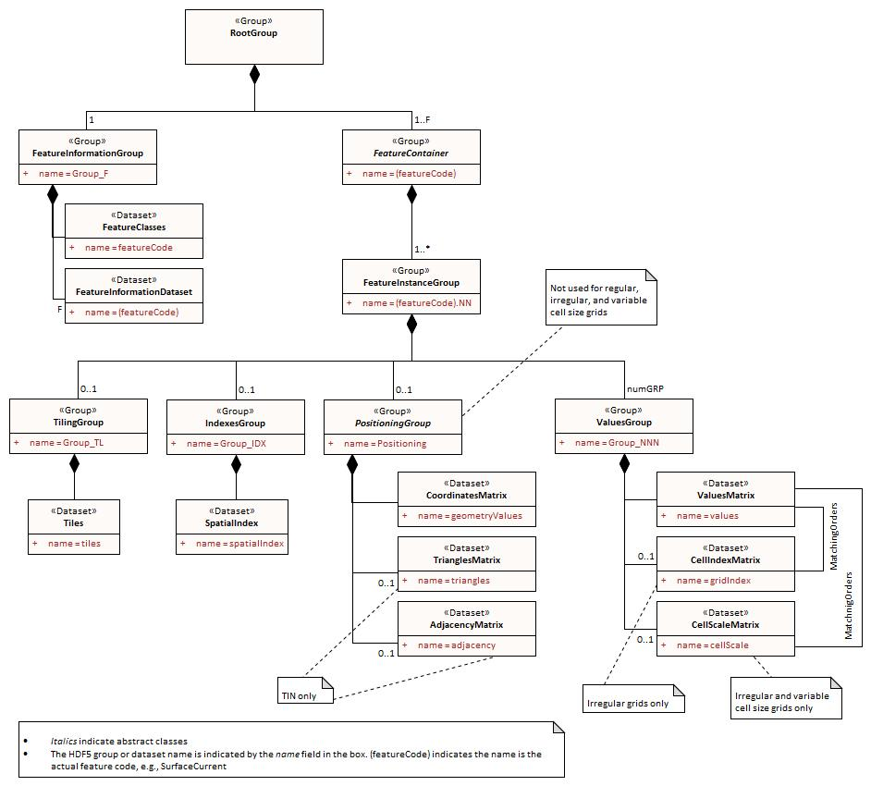
Detailed logical structure

Slide 10
Other additions
Some guidance for product specification developers on how to define the HDF5 data format for a product using this profile.
Guidance on extensions:
Product specifications may extend the format by defining new data structures, but all extensions must be such that implementations can ingest and portray data without processing the additional data structures.
Product-specific metadata can be added, but should not have any effects on processing or portrayal (i.e., display-only). Things that affect portrayal or processing should be submitted as an S-100 update proposal.
Draft contains some development guidance for implementers.

Slide 11
Open questions and judgement calls
Harmonization with Climate Forecast (CF) conventions is TBD.
Lower-level group structure:
Retain separation into tiling, index, geometry, and value groups?
Place the tiles, index, geometry, and value as different HDF5 datasets in the same group?
Place all time series data in the same group instead of Group_NNNs?
Combine coordinate and data values into one dataset?
Combining means some uniformity will be lost, since the record type will depend on the type of coverage.
Encoding of polygons referenced by features (e.g., influence polygons, meta-features such as DataCoverage):
Retain current approach – reference a GML or ISO 8211 dataset
Develop a data structure to encode polygons as vector objects inside the HDF5 file (including exterior and interior rings).
Encode polygons as blobs based on another format – e.g., encode the GML GM_Surface object verbatim (using only inline coordinates).

Slide 12
Open questions - 2
Add scale offset encoding for both data values and coordinates, for more compact storage?
Allow storage of coordinates as integers instead of floating point values using the coordinate multiplication factor technique?
For uniformity, store data values for regular grids as 1-D compound array, like the other formats?
Notes:
Scale offset encoding – encode a base value as an attribute, then encode each entry in the array as an increment to the base.

Slide 13
Recommendations
Consider encoding time series using the T dimension instead of separate datasets or groups (e.g., 3-D time series data values are stored as XYZT arrays).

Slide 14
Next steps
Some changes may still happen based on feedback
Testing is required
The teams that are currently looking to use HDF5 are involved in the feedback and review
Agree in principle to the concepts that are being added and then work everything out via correspondence in the next couple of months.

